Slide 1

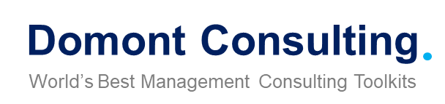
HR and Talent Management Toolkit
Overview and Approach

Slide 2
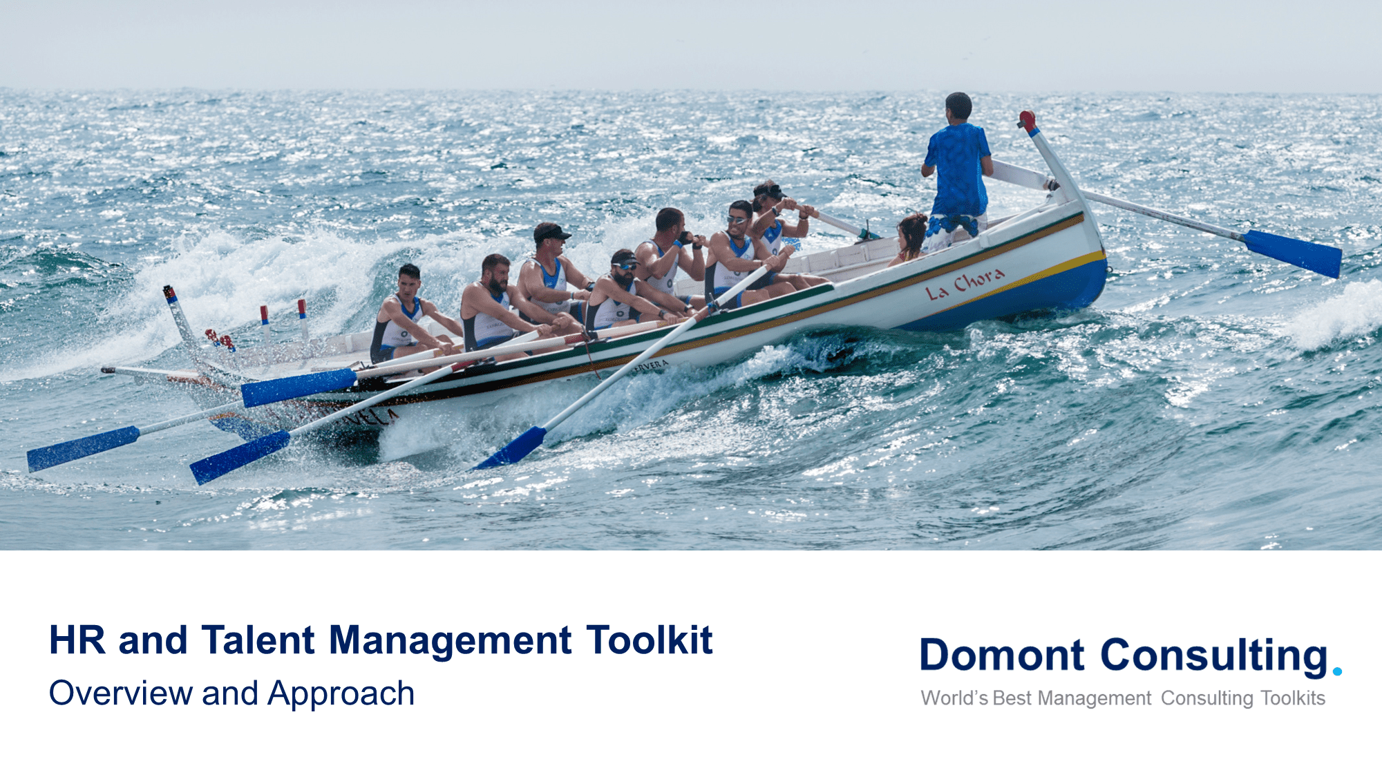
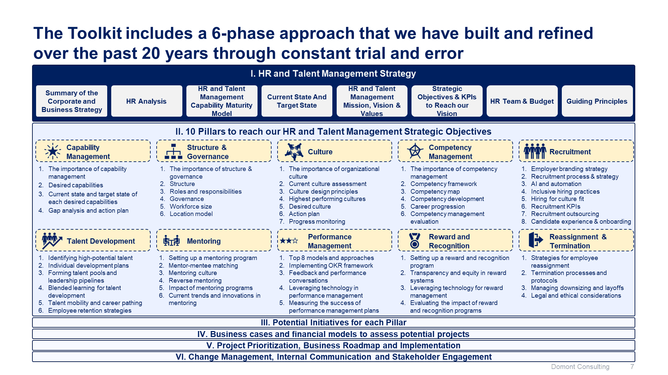
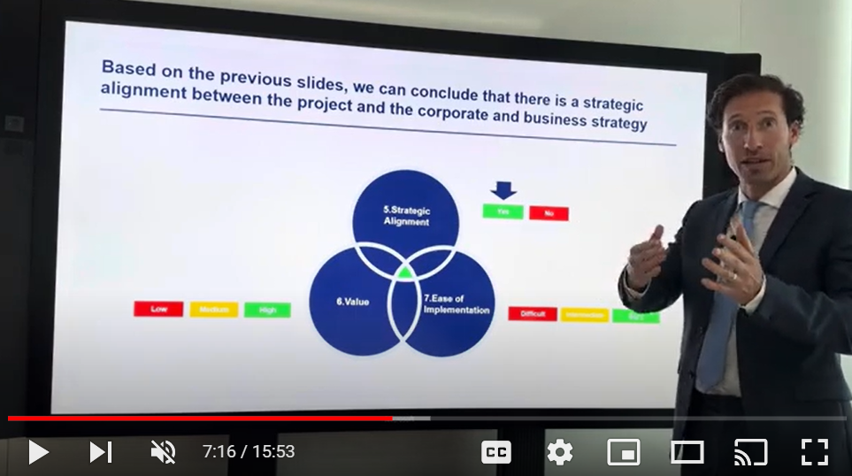
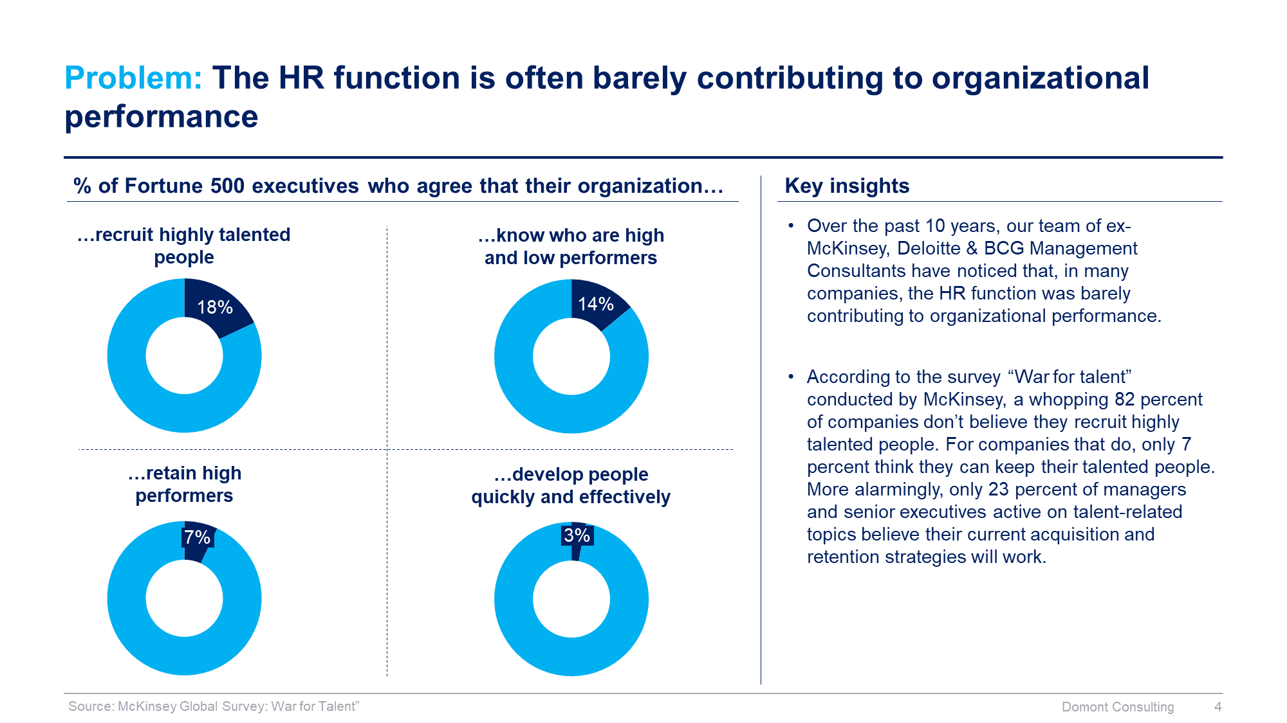
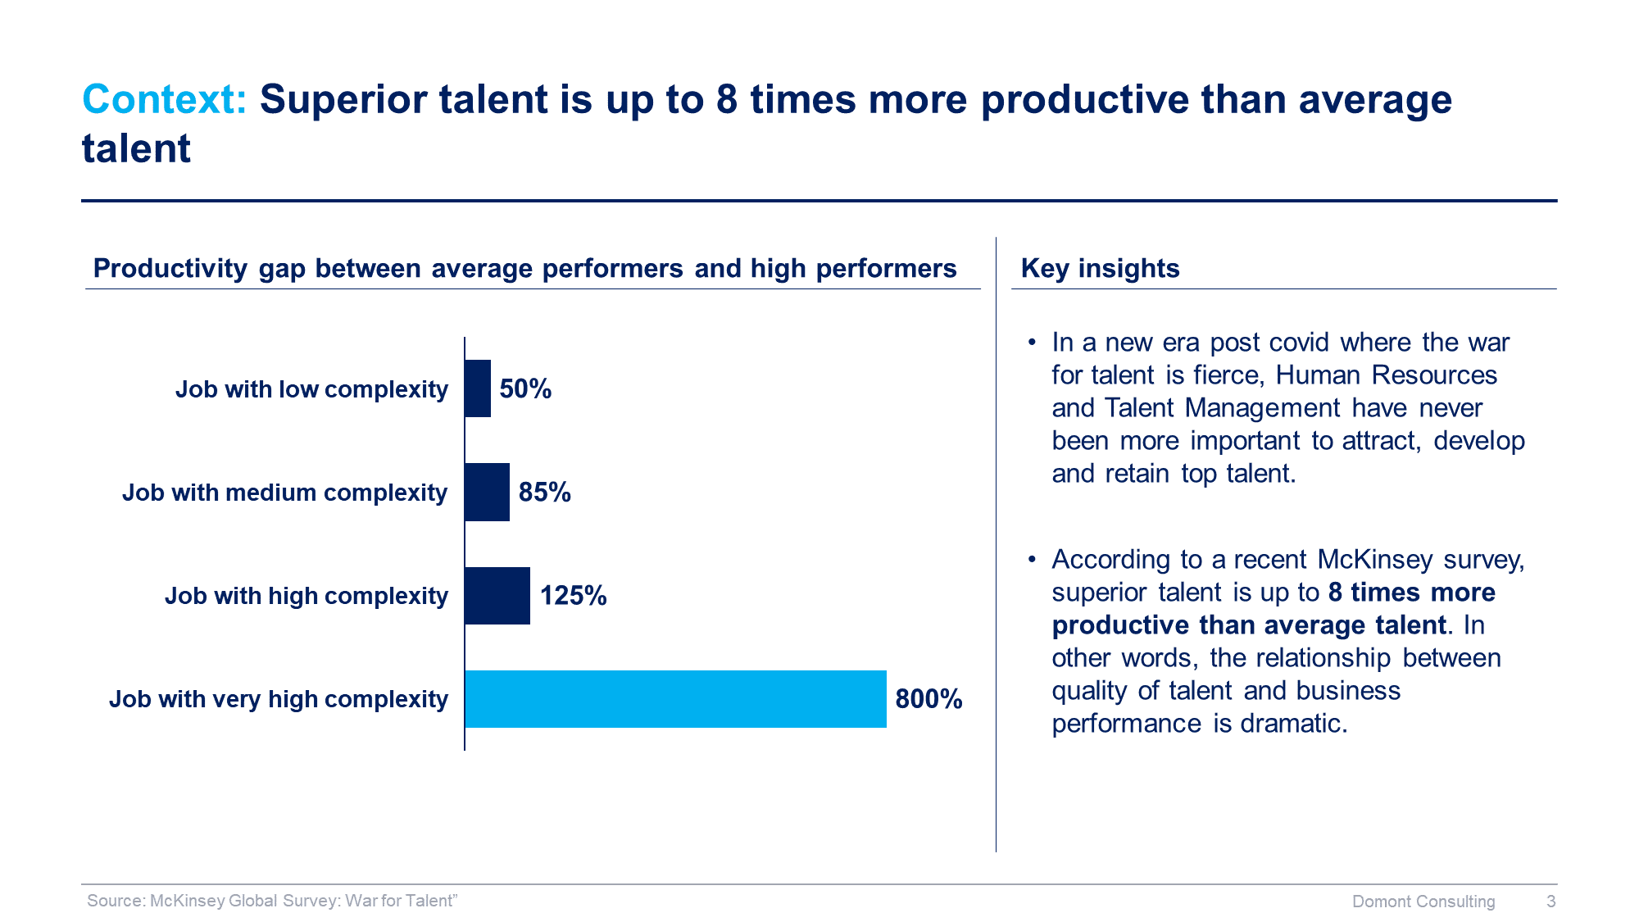
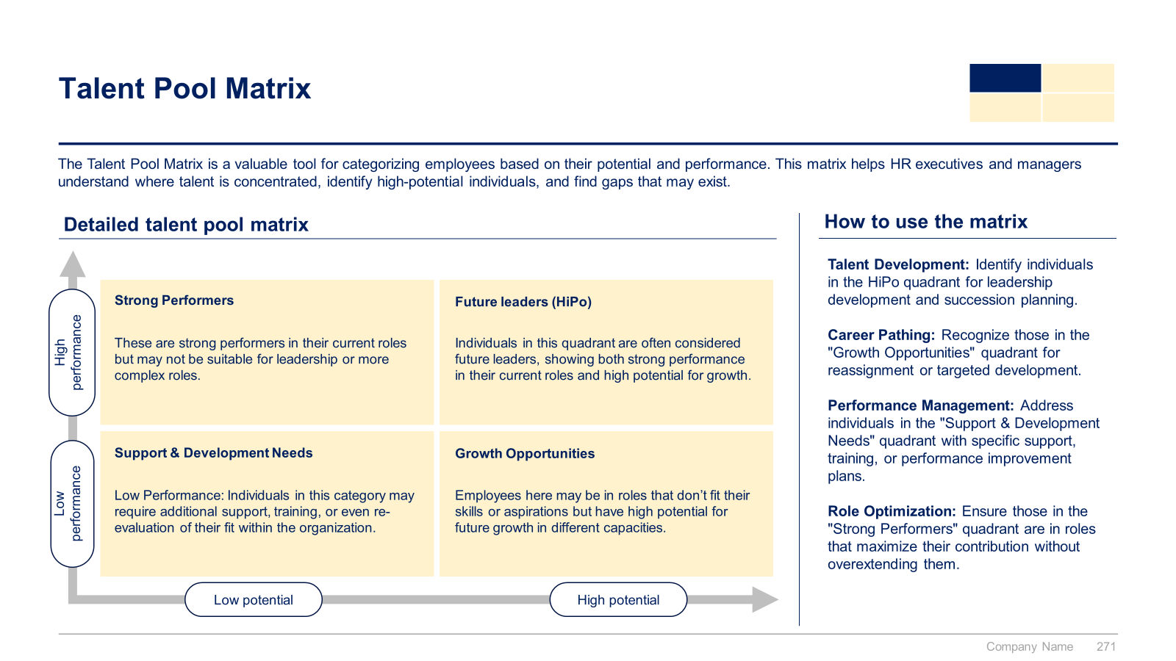
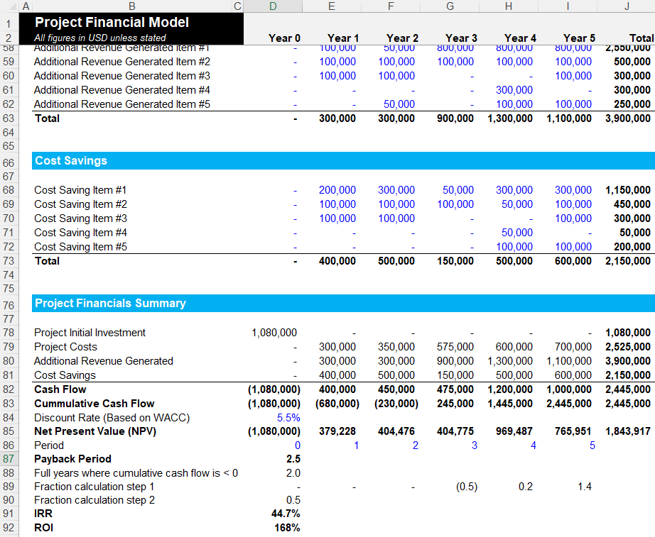
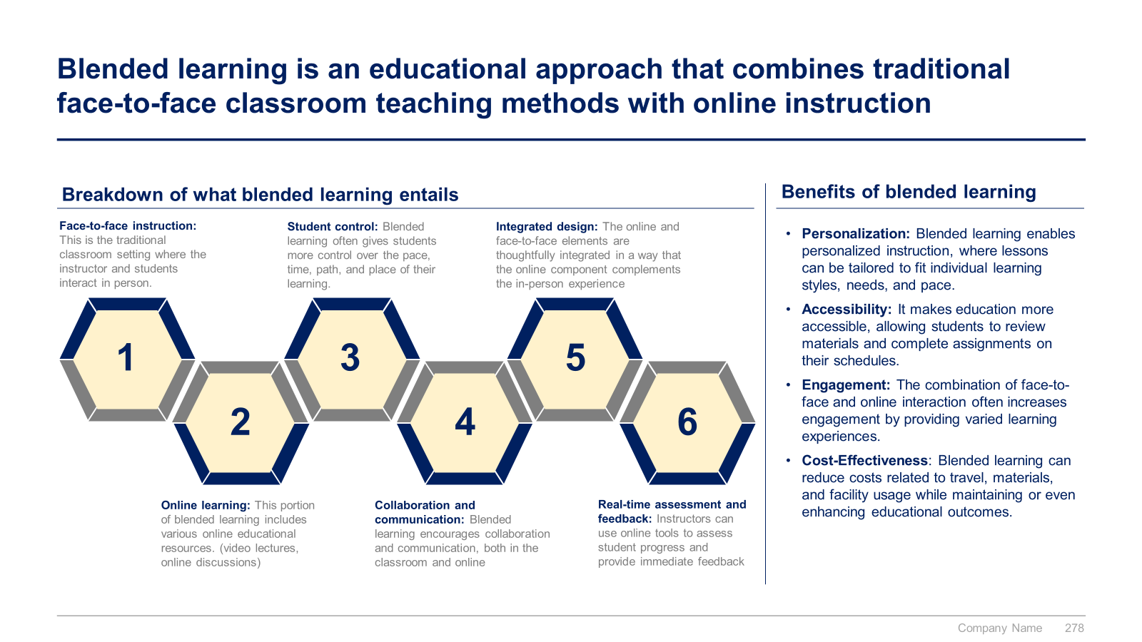
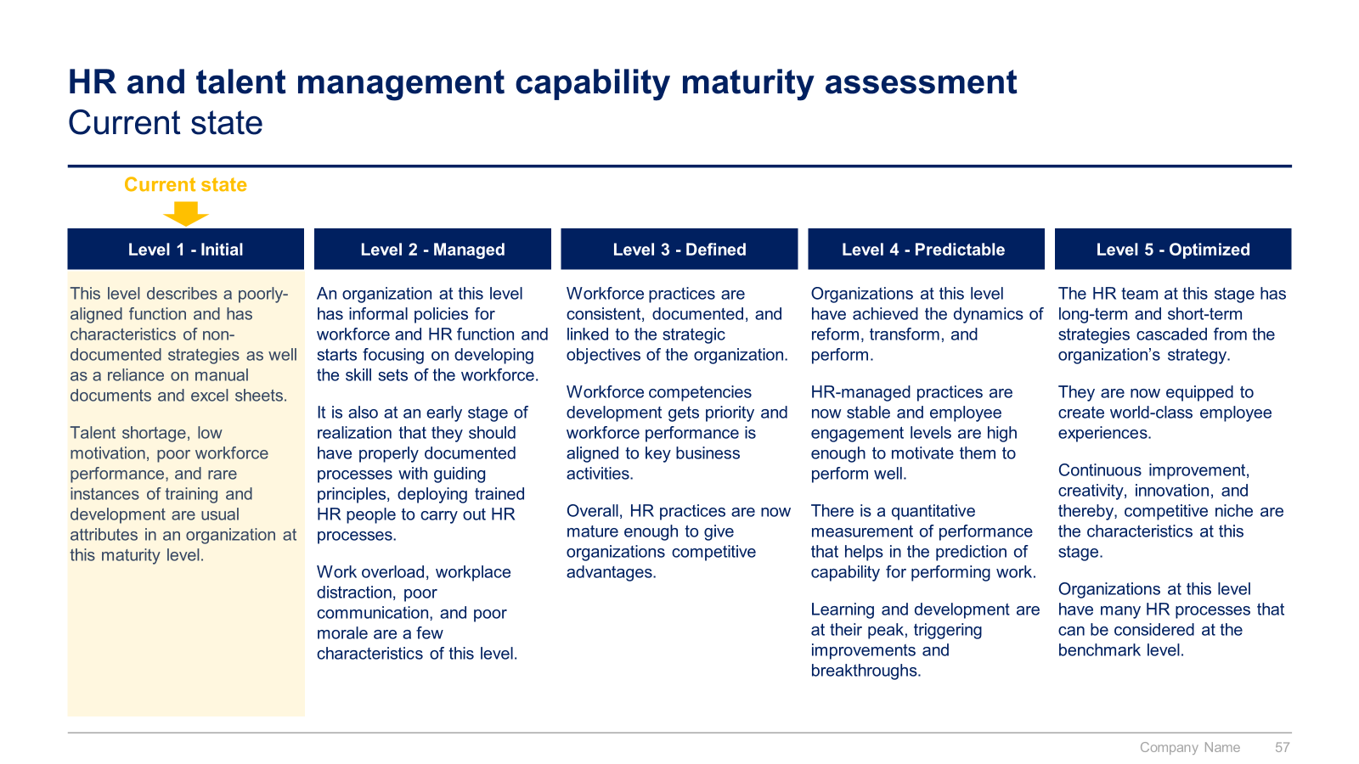

Slide 3


Introduction
This Toolkit was created by ex-McKinsey, Deloitte and BCG Management Consultants after 3,000+ hours of work. It shares our combined 100+ years of experience advising executive teams around the world. It includes all the Frameworks, Best Practices & Templates required to improve the “HR and Talent Management” function of your organization, and help you attract, develop and retain top talent.
Join the 200,000+ Executives, Consultants & Entrepreneurs who are already leveraging our Management Consulting Toolkits to improve the performance of their organization and boost their own career.
If you have any questions, send us an email at support@domontconsulting.com and one of our ex-McKinsey, Deloitte & BCG Management Consultants will get back to you within 2 business days.
Aurelien Domont
Management Consultant
Domont Consulting Managing Director

Slide 4
Context: Superior talent is up to 8 times more productive than average talent
Productivity gap between average performers and high performers
Key insights
In a new era post covid where the war for talent is fierce, Human Resources and Talent Management have never been more important to attract, develop and retain top talent.
According to a recent McKinsey survey, superior talent is up to 8 times more productive than average talent. In other words, the relationship between quality of talent and business performance is dramatic.
Job with low complexity
Job with medium complexity
Job with high complexity
Job with very high complexity
Source: McKinsey Global Survey: “War for Talent”

Slide 5
Problem: The HR function is often barely contributing to organizational performance
% of Fortune 500 executives who agree that their organization…
Key insights
…recruit highly talented people
…know who are high and low performers
Over the past 10 years, our team of ex-McKinsey, Deloitte & BCG Management Consultants have noticed that, in many companies, the HR function was barely contributing to organizational performance.
According to the survey “War for talent” conducted by McKinsey, a whopping 82 percent of companies don’t believe they recruit highly talented people. For companies that do, only 7 percent think they can keep their talented people. More alarmingly, only 23 percent of managers and senior executives active on talent-related topics believe their current acquisition and retention strategies will work.
…retain high performers
…develop people quickly and effectively
7%
3%
Source: McKinsey Global Survey: “War for Talent”

Slide 6












Solution: Our ex-McKinsey, Deloitte & BCG consultants created a Toolkit to help you reach your value creation objectives
What’s inside the Toolkit?
Who created the Toolkit?
The Toolkit was created by former McKinsey, Deloitte & BCG management consultants.
Best Practices
Frameworks
Number of professionals leveraging our Toolkits
Advice from
tier-1 Management Consultants
Tools
There are 200,000+ Executives, Consultants & Entrepreneurs leveraging our Toolkits to improve the performance of their organization.
Real-life Examples
Templates
Trusted by small and large organizations
Video Training
Step-by-step Tutorials

Slide 7
Our Toolkit will help you fulfill multiple objectives
The HR and Talent Management Toolkit includes frameworks, tools, templates, tutorials, real-life examples, video training, and best practices to help you:
Define and Implement your HR and Talent Management Strategy: (1) Summary of the Corporate and Business Strategy, (2) HR Analysis, (3) HR and Talent Management Capability Maturity Model, (4) Current State And Target State, (5) HR and Talent Management Mission, Vision & Values, (6) Strategic Objectives & KPIs to Reach our Vision, (7) Team & Budget, (8) Guiding Principles
Define the 10 Pillars required to reach your HR and Talent Management Strategic Objectives: (1) Capability Management, (2) Structure & Governance, (3) Culture, (4) Competency Management, (5) Recruitment, (6) Talent Development, (7) Mentoring, (8) Performance Management, (9) Reward and Recognition, (10) Reassignment & Termination
List your Potential Initiatives for each pillar
Create your Business Cases and Financial Models to assess your list of potential initiatives
Prioritize, Plan and Implement your Projects: (1) Project Prioritization, (2) Business Roadmap, (3) Governance, (4) Dashboards, (5) Project Implementation: Agile Methodology, Design Thinking and Traditional Methodology, (6) Continuous Improvement (7) Post Projects Evaluation and Lessons Learnt, (8) Post Program Evaluation and Lessons Learnt
Define and implement your change management strategy and internal communication strategy: (1) Change management strategy, (2) Change management plans, (3) Implementation, tracking and progress management, (4) Effective communication, (5) Stakeholder engagement strategy
1
2
3
4
5
6

Slide 8

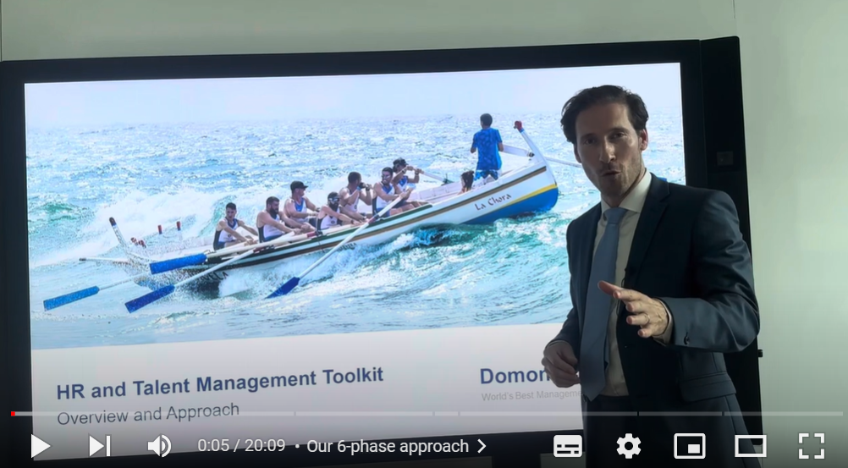
Video demonstration of the HR and Talent Management Toolkit
Video Demo Access
Video Demo Visual
Select “Slide Show” mode and then click on the link below or on the image on the right to access this video demo.
You can also access the video by copy pasting the following URL in your browser:
https://youtu.be/2S3UUpgfsVw

Slide 9










The Toolkit includes a 6-phase approach that we have built and refined over the past 20 years through constant trial and error
I. HR and Talent Management Strategy
Summary of the Corporate and Business Strategy
HR Analysis
HR and Talent Management Capability Maturity Model
Current State And Target State
HR and Talent Management Mission, Vision & Values
Strategic Objectives & KPIs to Reach our Vision
HR Team, Budget & Service Delivery Model
Guiding Principles
II. 10 Pillars to reach our HR and Talent Management Strategic Objectives
Capability Management
Structure & Governance
Culture
Competency Management
Recruitment
The importance of capability management
Desired capabilities
Current state and target state of each desired capabilities
Gap analysis and action plan
The importance of structure & governance
Structure
Roles and responsibilities
Governance
Workforce size
Location model
The importance of organizational culture
Current culture assessment
Culture design principles
Highest performing cultures
Desired culture
Action plan
Progress monitoring
The importance of competency management
Competency framework
Competency map
Competency development
Career progression
Competency management evaluation
Employer branding strategy
Recruitment process & strategy
AI and automation
Inclusive hiring practices
Hiring for culture fit
Recruitment KPIs
Recruitment outsourcing
Candidate experience & onboarding
Talent Development
Mentoring
Performance Management
Reward and Recognition
Reassignment & Termination
Talent assessment
Required competencies
Individual development plans
Effective training programs
Talent mobility and career pathing
Employee retention strategies
Succession plan
Setting up a mentoring program
Mentor-mentee matching
Mentoring culture
Reverse mentoring
Impact of mentoring programs
Current trends and innovations in mentoring
Top 8 models and approaches
Implementing OKR framework
Feedback and performance conversations
Leveraging technology in performance management
Measuring the success of performance management plans
Setting up a reward and recognition program
Transparency and equity in reward systems
Leveraging technology for reward management
Evaluating the impact of reward and recognition programs
Strategies for employee reassignment
Termination processes and protocols
Managing downsizing and layoffs
Legal and ethical considerations
III. Potential Initiatives for each Pillar
IV. Business cases and financial models to assess potential projects
V. Project Prioritization, Business Roadmap and Implementation
VI. Change Management, Internal Communication and Stakeholder Engagement

Slide 10
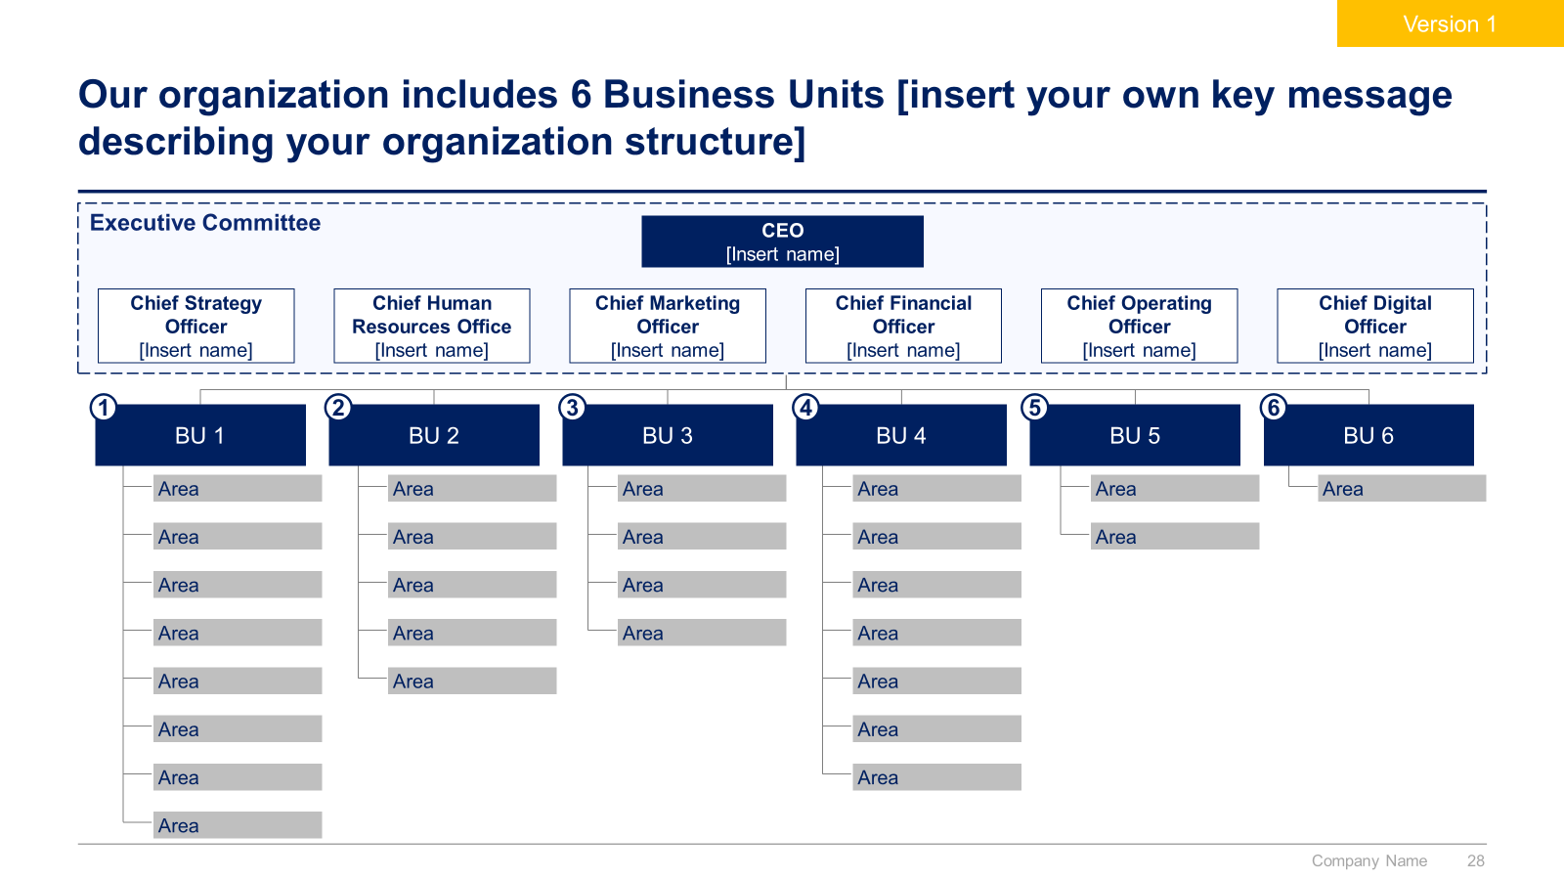
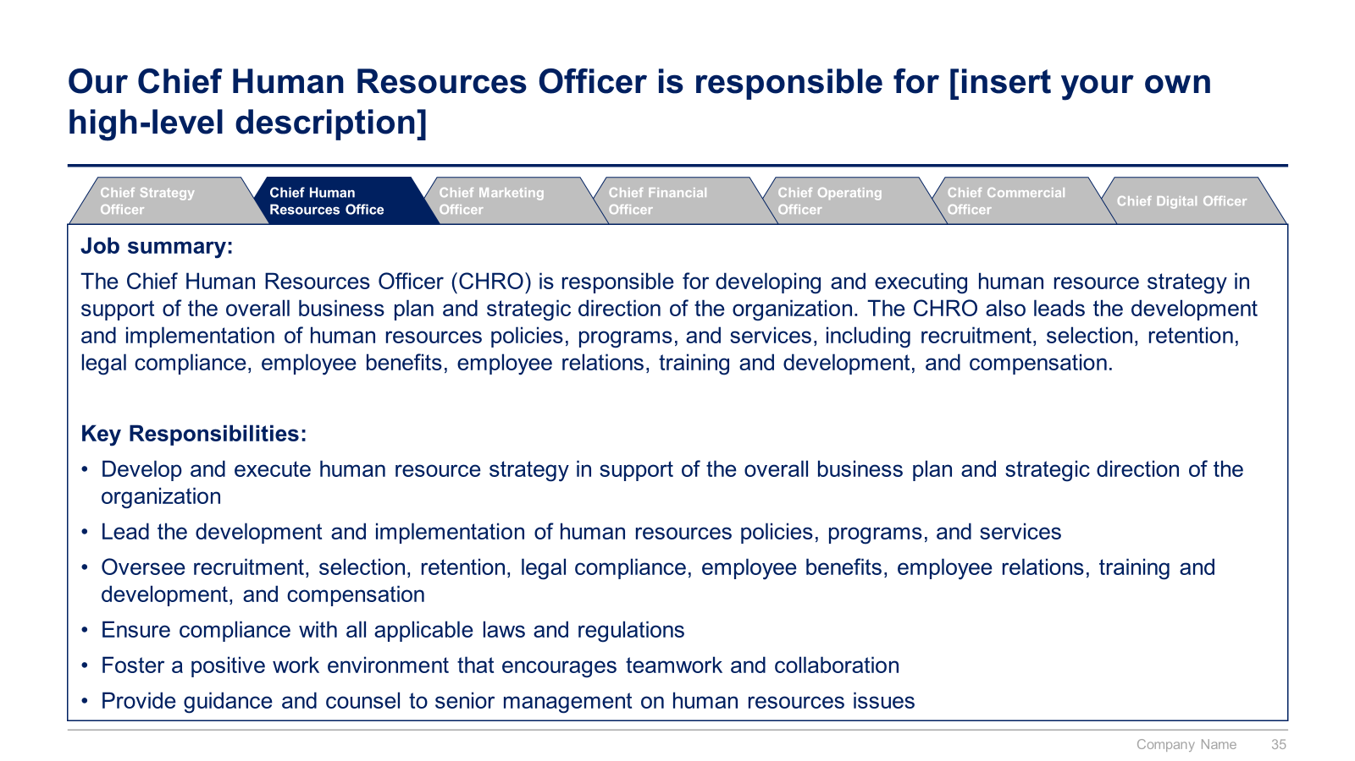
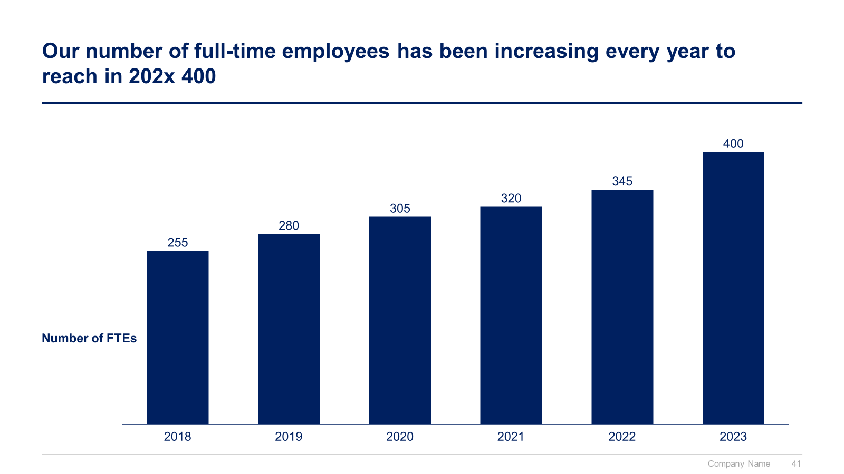
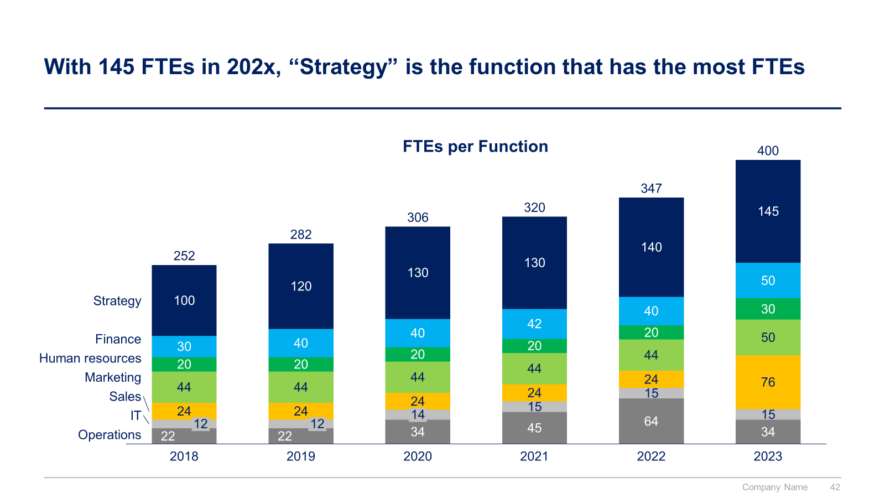
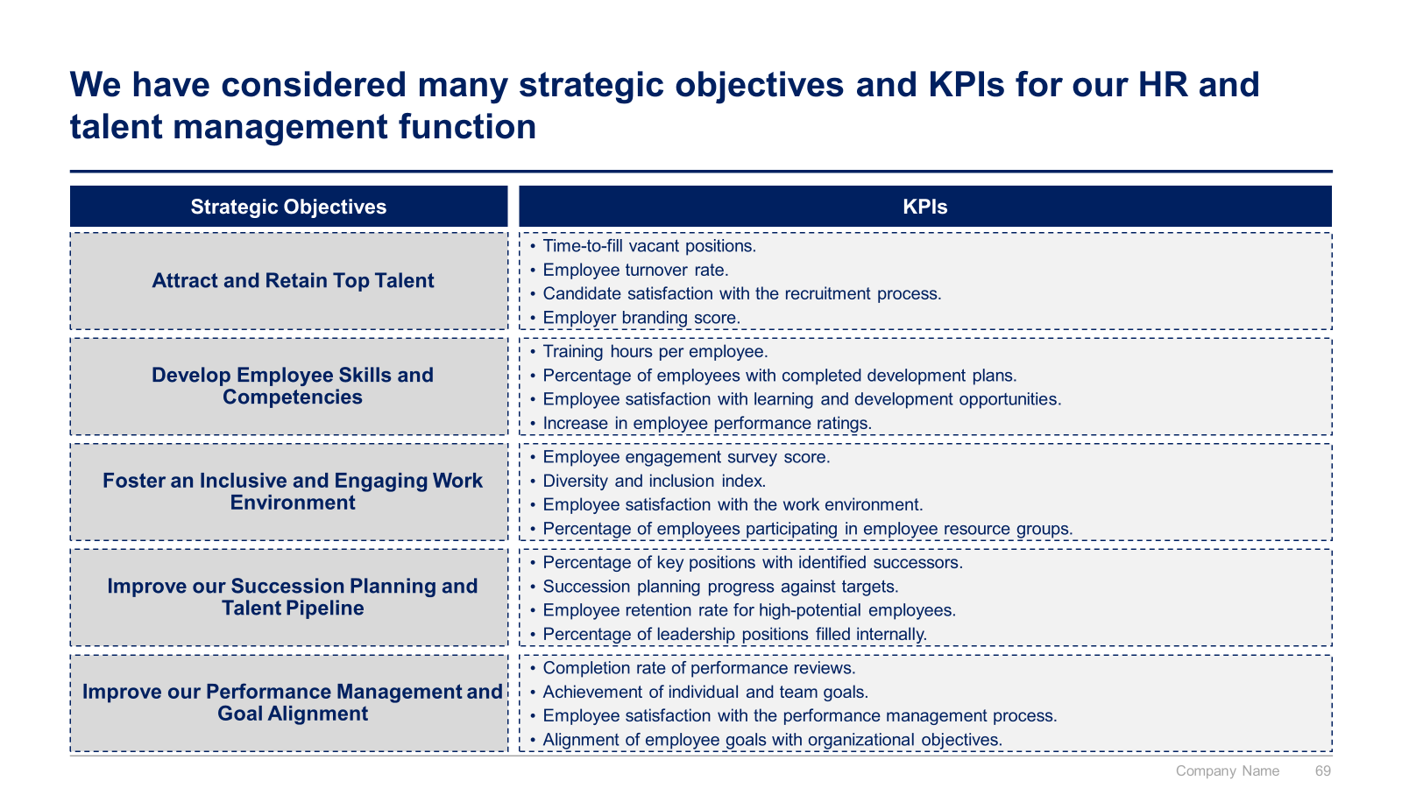
Small preview of the phase 1 ‘HR and Talent Management Strategy’

Slide 11
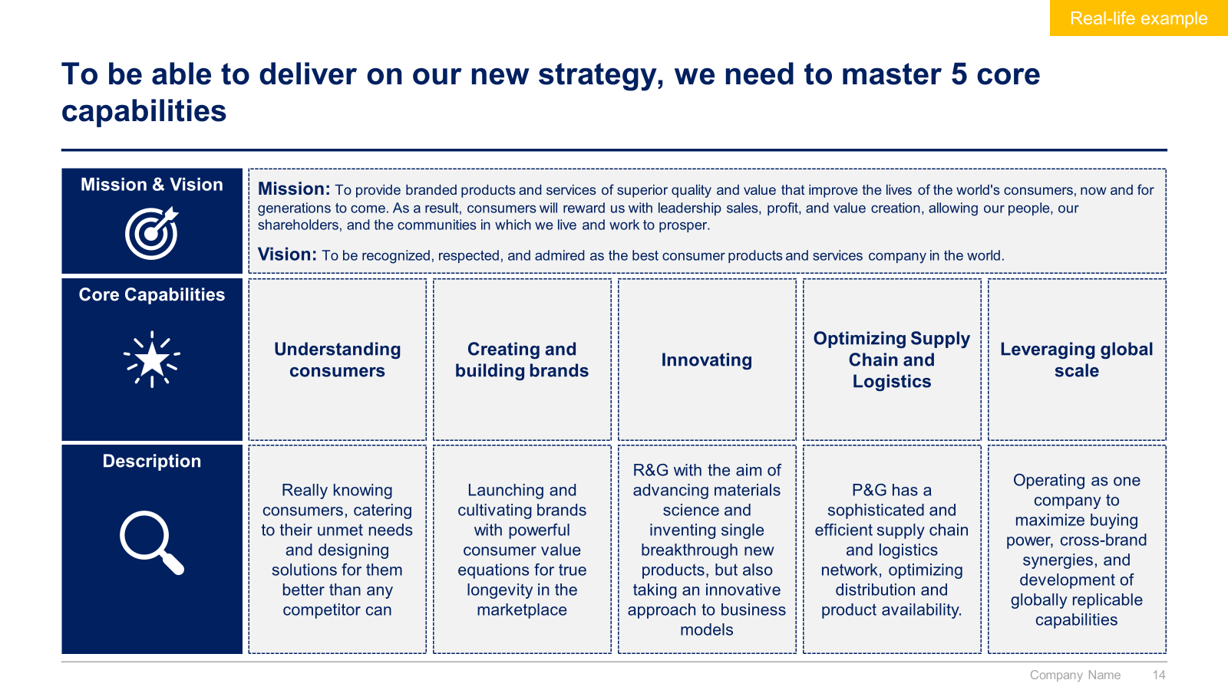
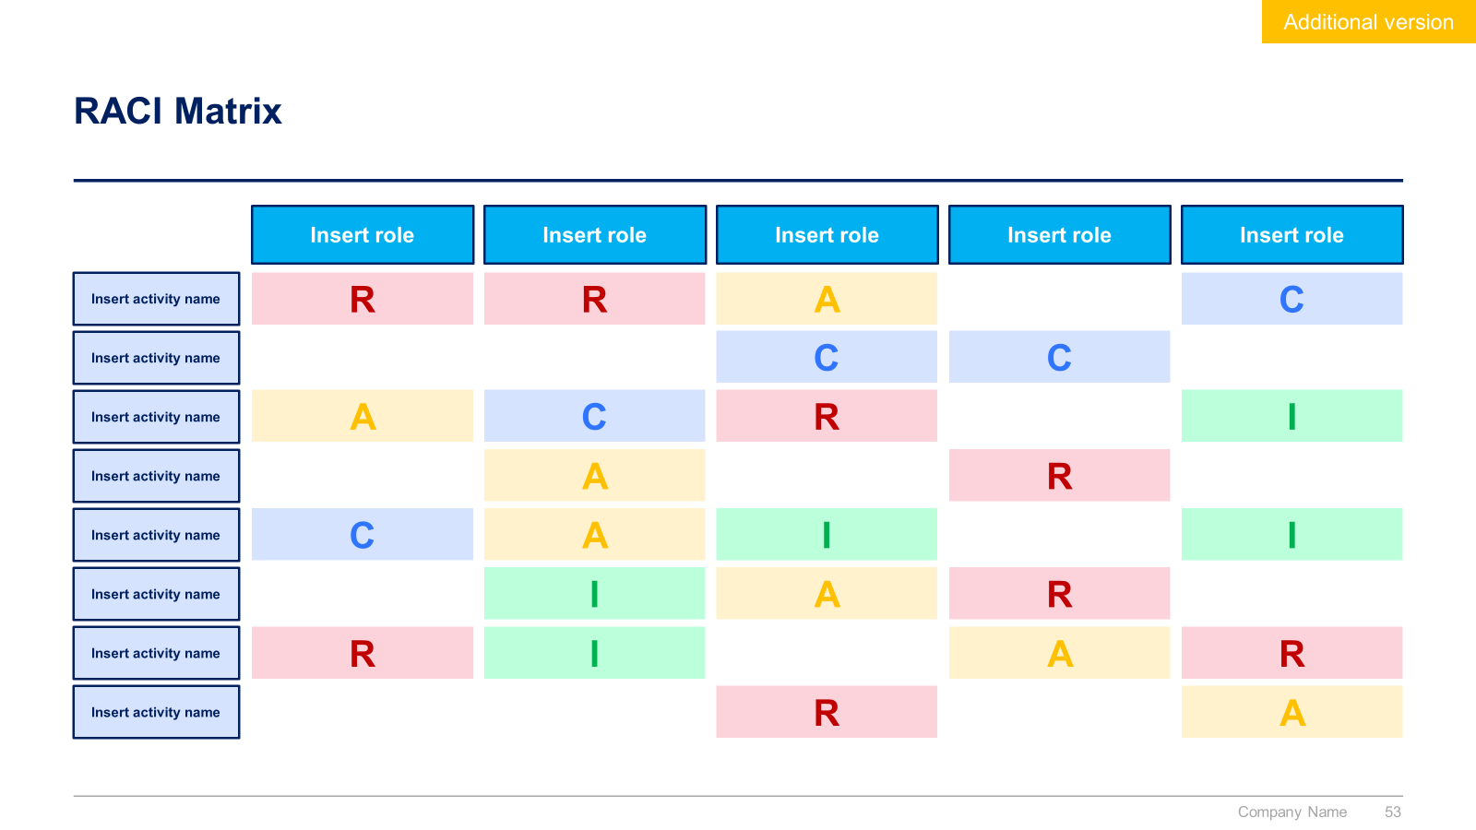
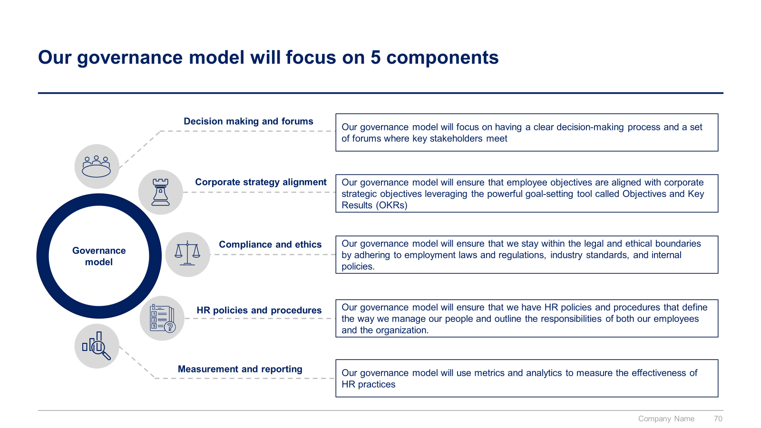
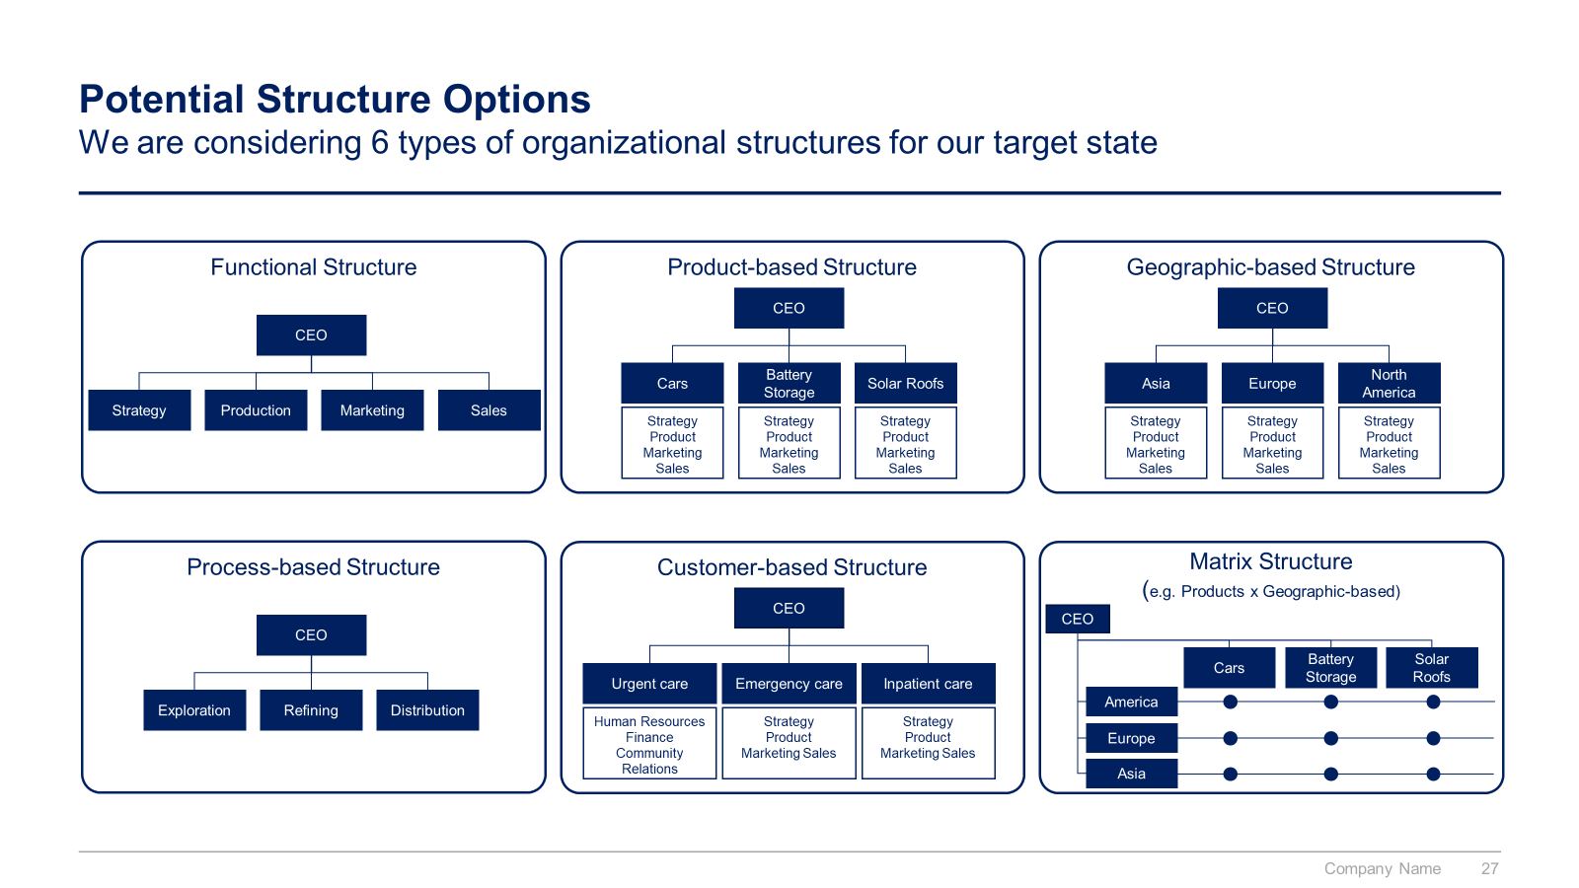
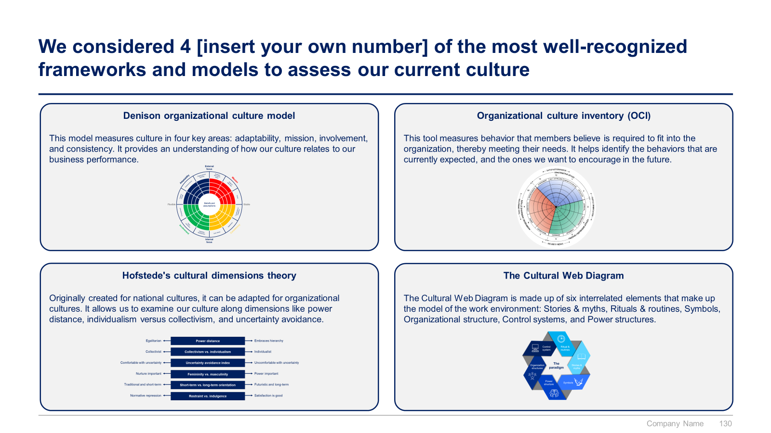
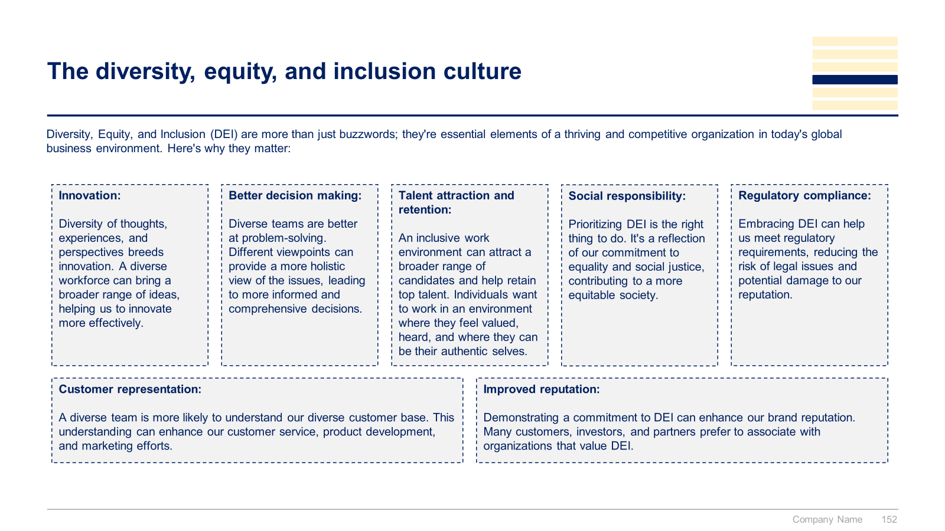
Small preview of the phase 2 ‘10 Pillars to reach our HR and Talent Management Strategic Objectives’ (1/2)

Slide 12
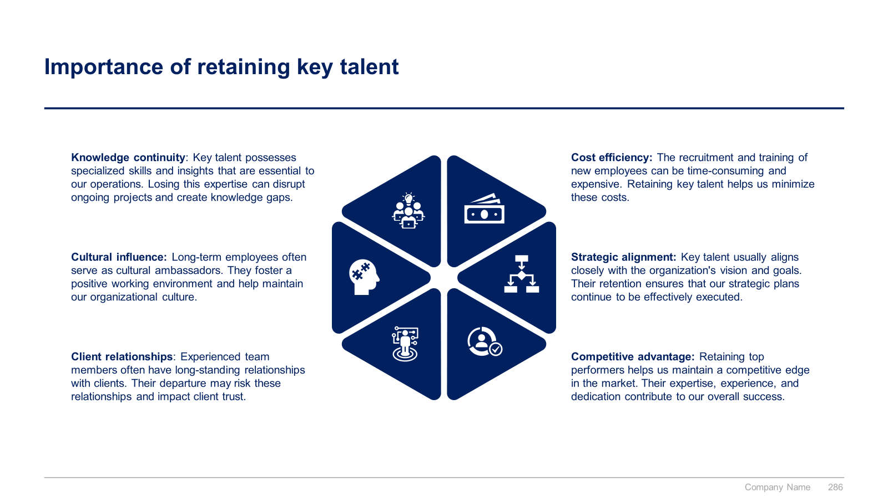
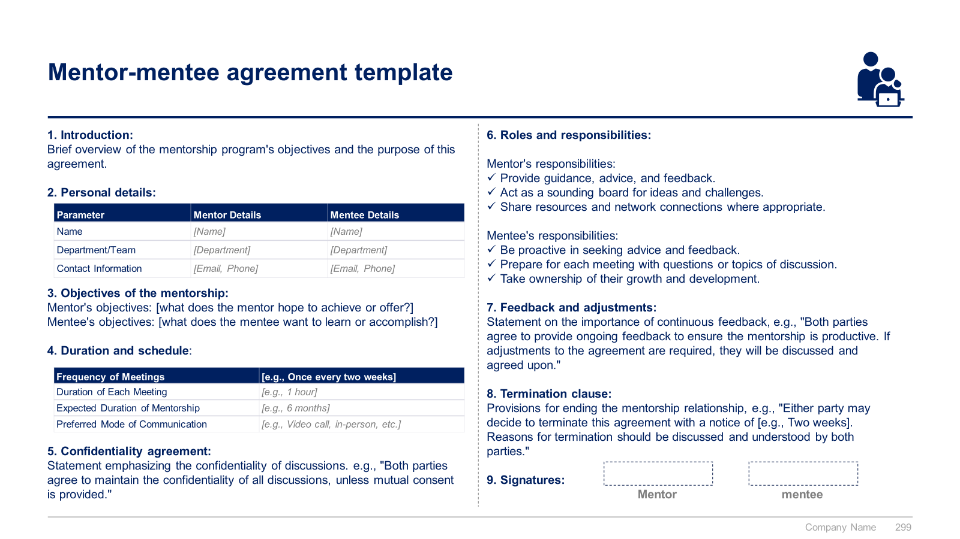
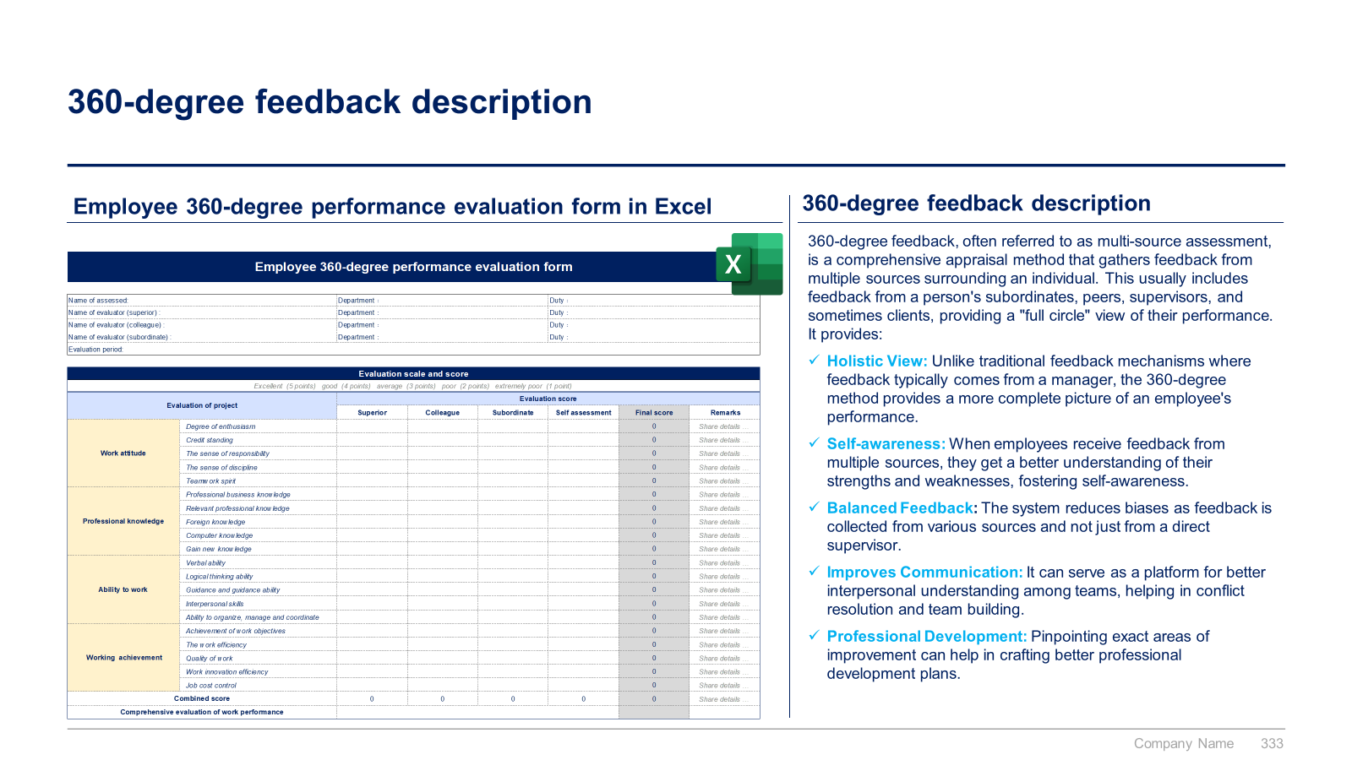
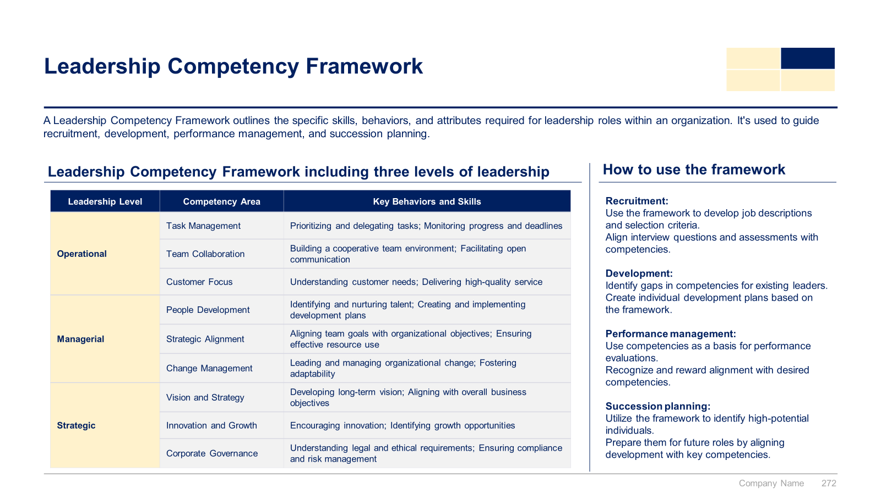
Small preview of the phase 2 ‘10 Pillars to reach our HR and Talent Management Strategic Objectives’ (2/2)

Slide 13
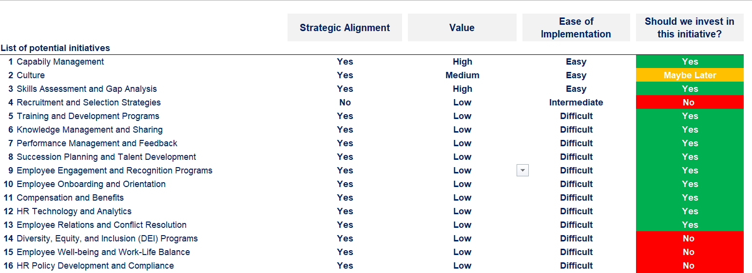
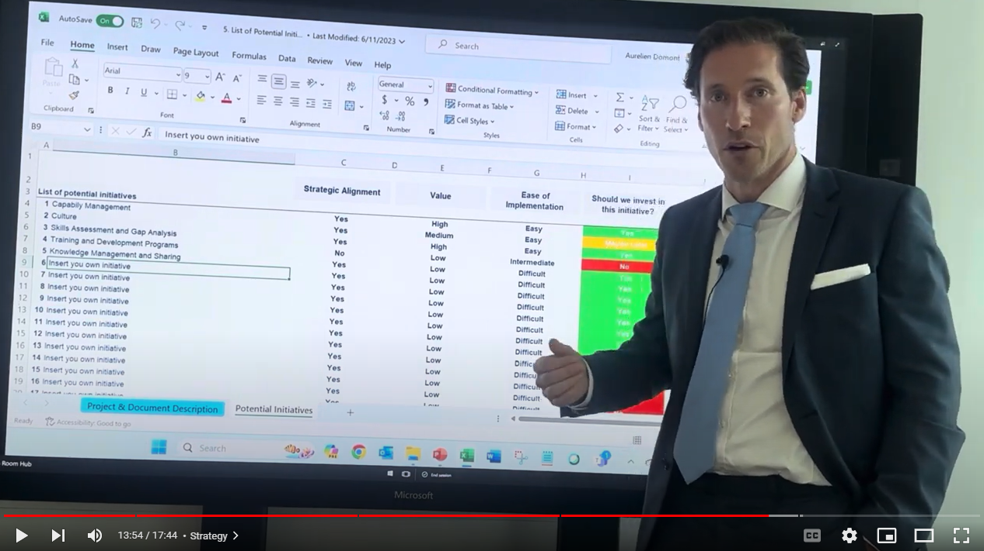
Small preview of the phase 3 ‘Potential Initiatives for each Pillar’

Slide 14
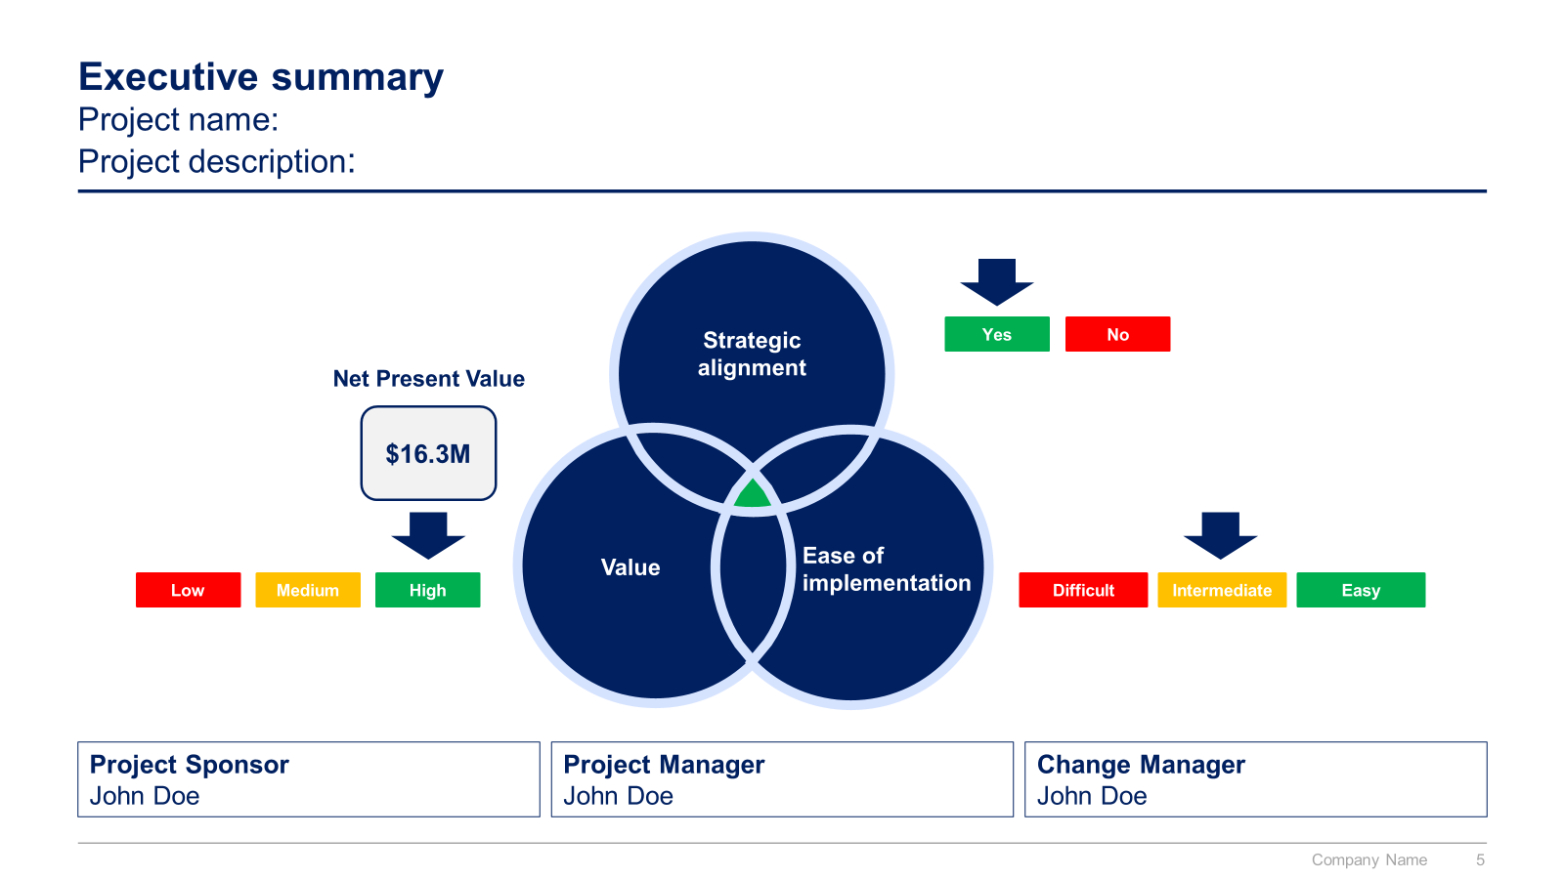
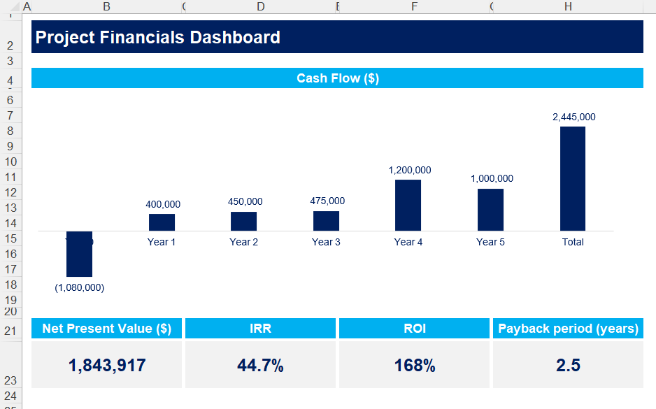
Small preview of the phase 4 ‘Business cases and financial models to assess potential projects’

Slide 15
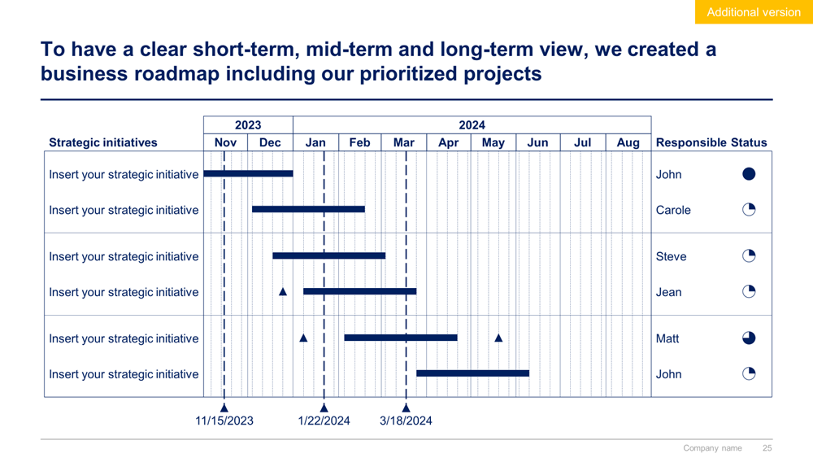
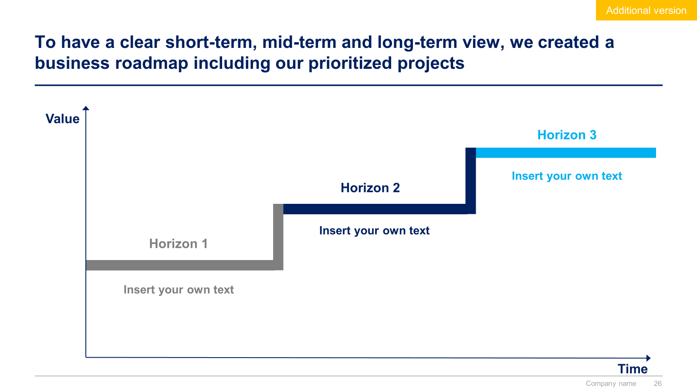
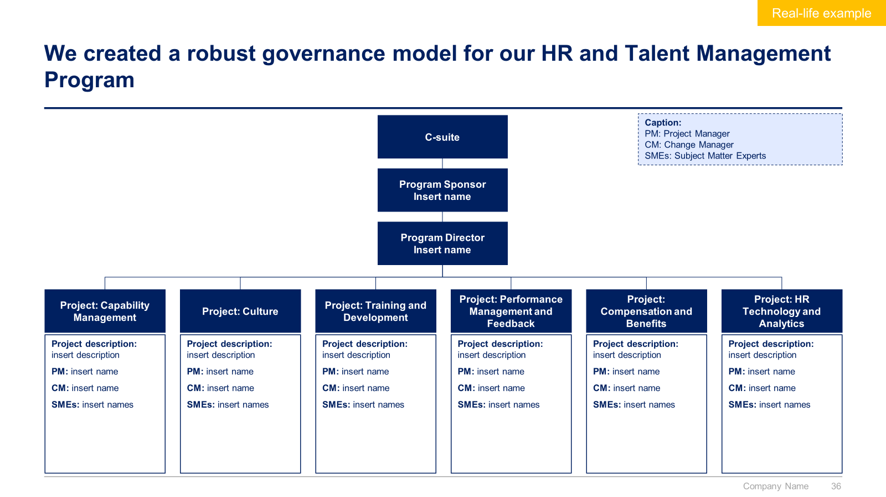
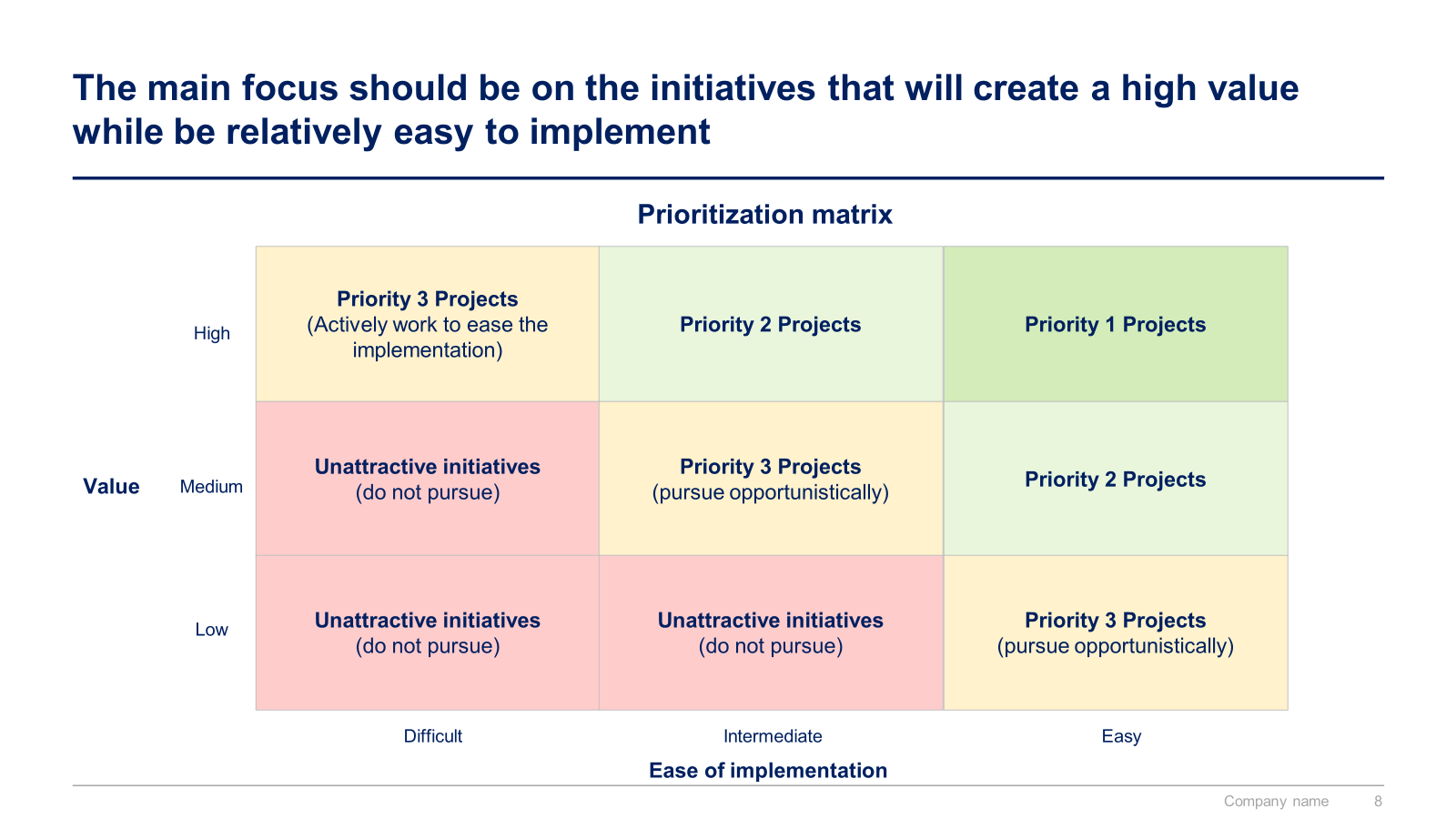
Small preview of the phase 5 ‘Project Prioritization, Business Roadmap and Implementation’

Slide 16
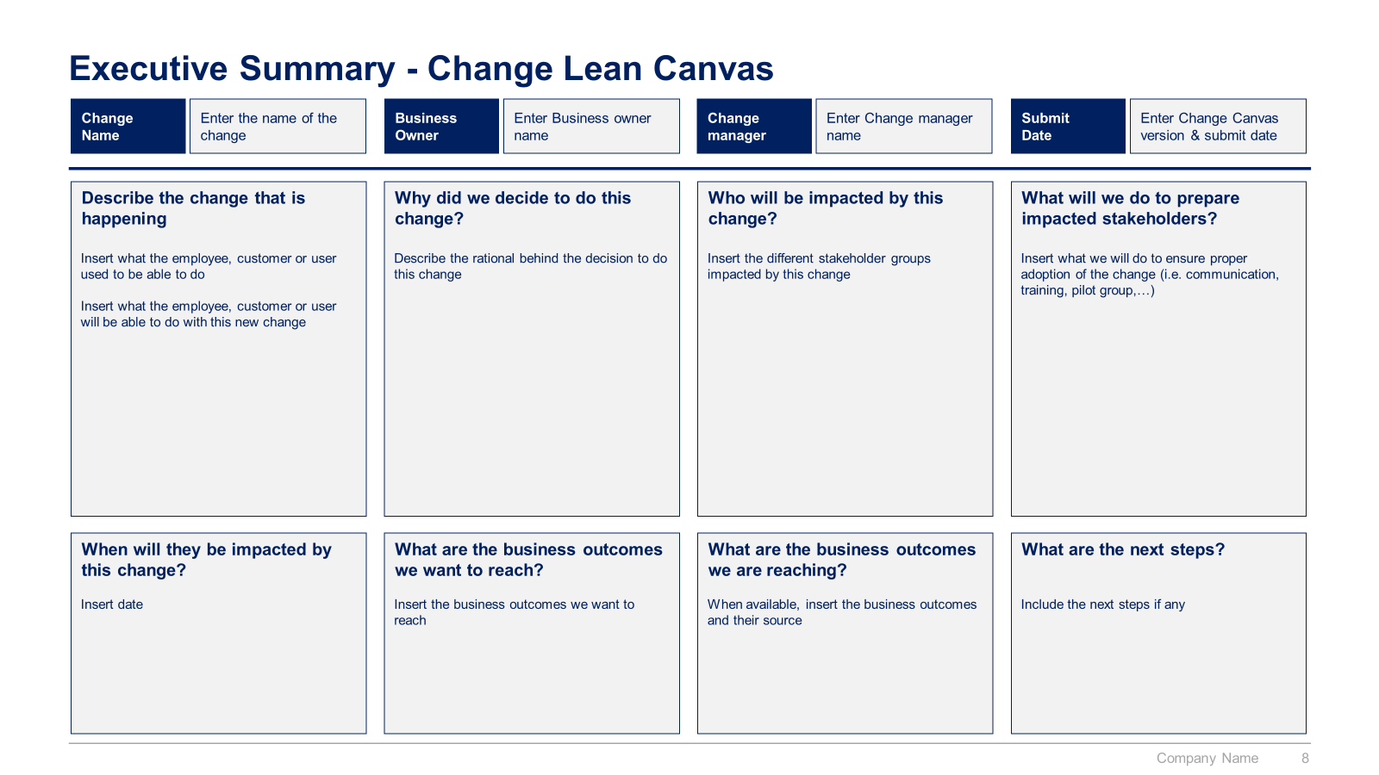
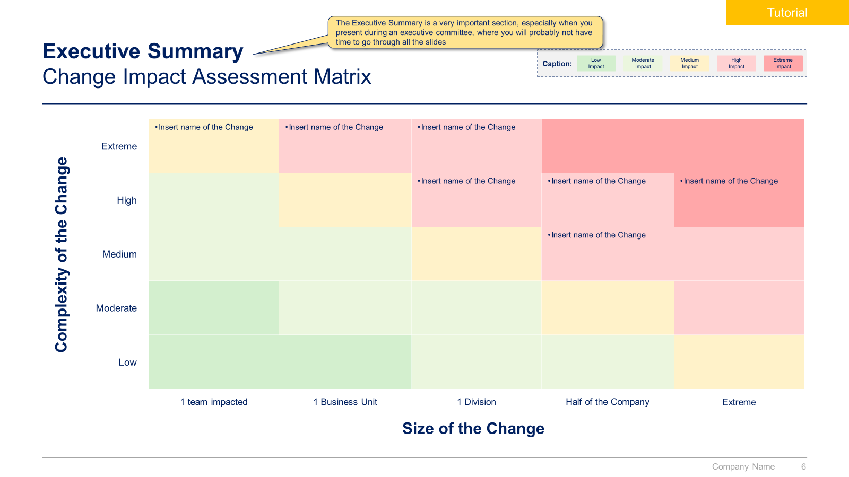
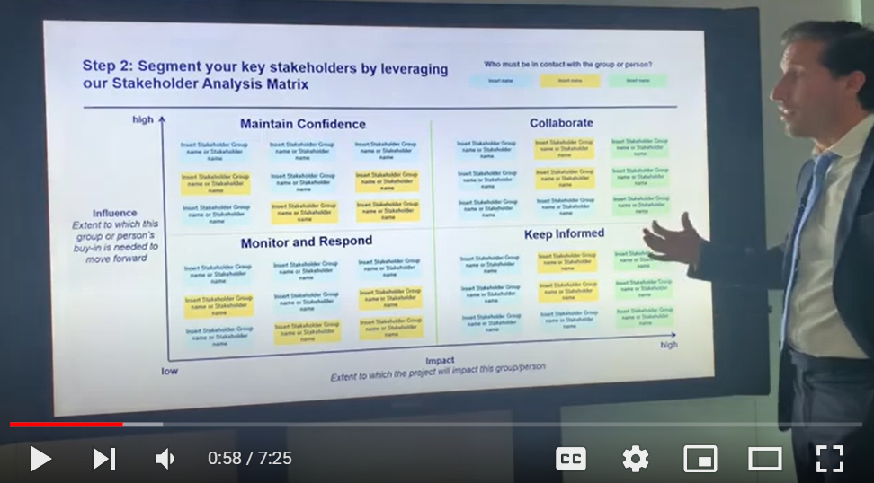
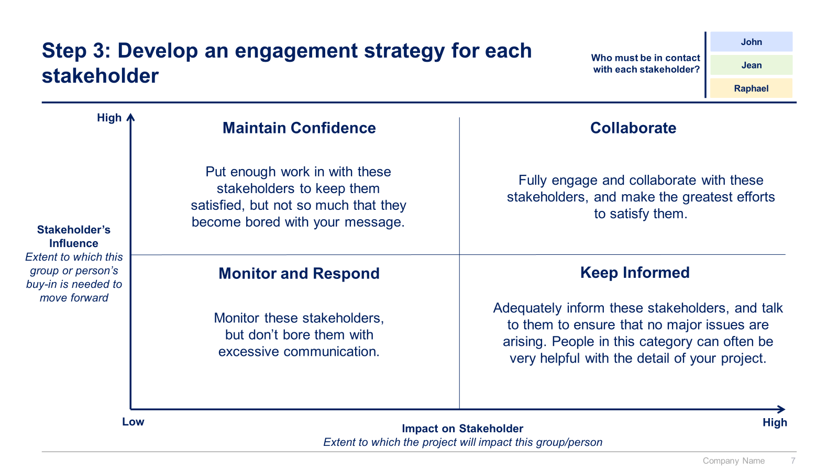
Small preview of the phase 6 ‘Change Management, Internal Communication and Stakeholder Engagement’

Slide 17



The Toolkit includes multiple PowerPoint slides, Excel sheets and Video training that you can download on your device immediately after purchase
550 editable PowerPoint slides*
27 Excel sheets*
1 hour of Video training
Overview and Approach
HR and Talent Management Strategy
Ten Pillars
Potential Initiatives
Business Cases and Financial Models
Project Prioritization, Business Roadmap and Implementation
Change Management, Internal Communication & Stakeholder Engagement
*Please note that the number of Powerpoint slides and Excel sheets listed is the number of unique slides and sheets. For example, a Powerpoint slide that has been duplicated to facilitate our clients’ understanding only counts for one slide

Slide 18









Our Management Consulting Toolkits include 9 key benefits
Improve the growth & efficiency of your organization by leveraging Management Consulting Toolkits created by ex-McKinsey, Deloitte & BCG Consultants.
Make a great investment for your career & organization. It cost us US$8M+ over the past 10 years to create all our Toolkits. Get them for a fraction of this cost.
Get a competitive advantage. It’s like hiring Management Consultants to create all the practical Frameworks, Tools & Templates you need.
Get the job done quicker and never start from scratch again with our ready-made and fully editable Frameworks, Tools & Templates in Powerpoint & Excel.
Don't reinvent the wheel. We have already worked 30,000+ hours over the past 10 years to create all the Management Consulting Toolkits you need.
Improve the capabilities of your organization by learning how the Fortune 100 and Global Consulting Firms do it.
Decrease your costs. Hiring tier-1 Consultants for a project would cost you $300k+. Way more expensive than our Toolkits, which will last you a lifetime!
Become your organization’s subject matter expert and impress your stakeholders with world-class approaches to resolve common business problems.
Get free support and advice from our ex-McKinsey, Deloitte & BCG Management Consultants.

Slide 19
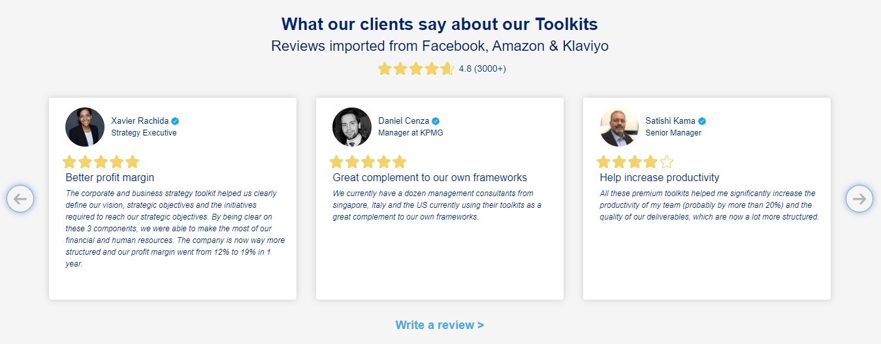
What our clients say about our Toolkits
Click here to see more reviews >

Slide 20

Join 200,000+ Executives, Consultants & Entrepreneurs leveraging our Toolkits to improve the performance of their organization
Trusted by small and large organizations
Customer satisfaction
4.8
Number of countries leveraging our Toolkits
160+
Number of professionals leveraging our Toolkits
200,000+
Daily rate of our ex-McKinsey, Deloitte and BCG Management Consultants
$3k-$4k

Slide 21
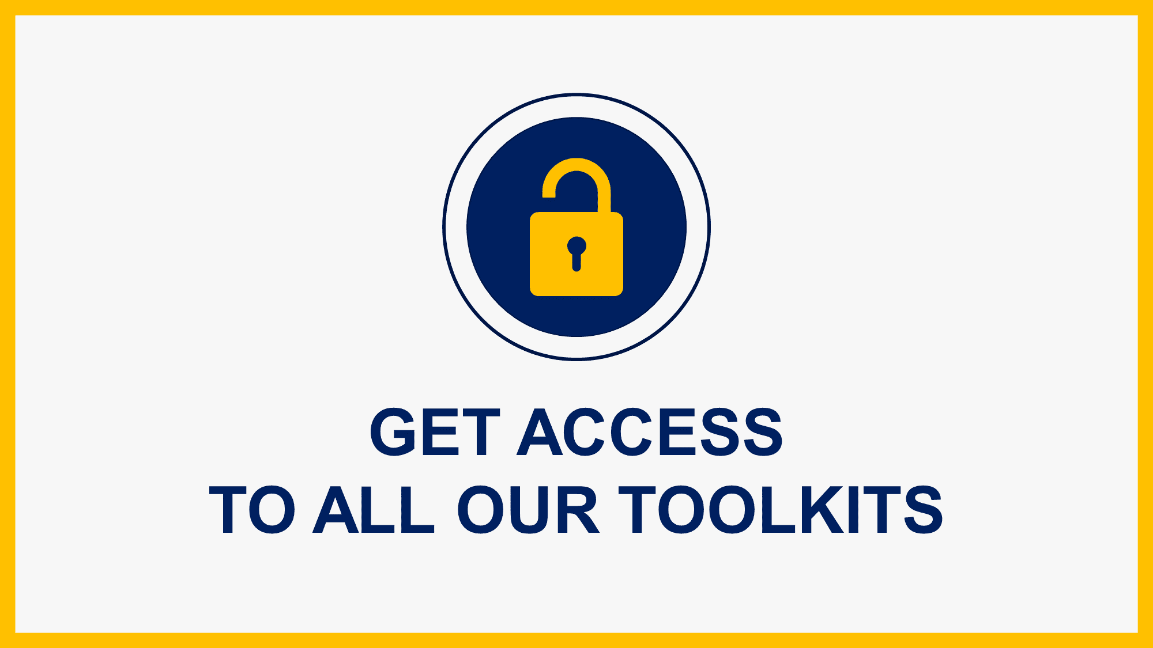
Interested in more than 1 Toolkit? Access all our Toolkits for half the price with our Gold Access
Gold Access
Click here to learn more

Slide 22
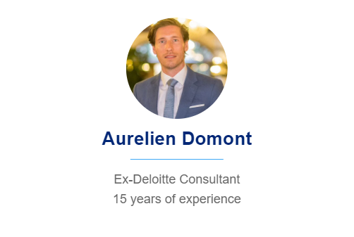
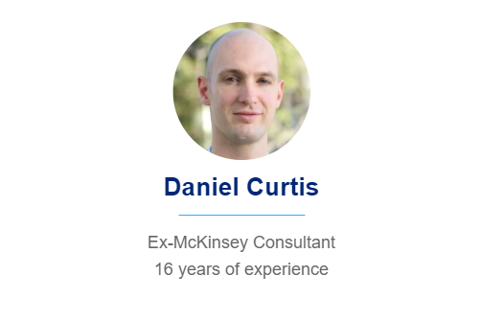
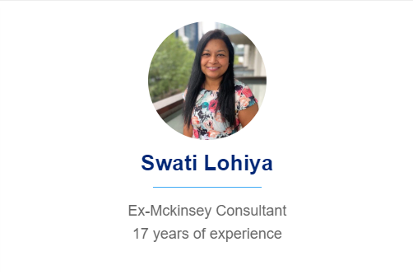
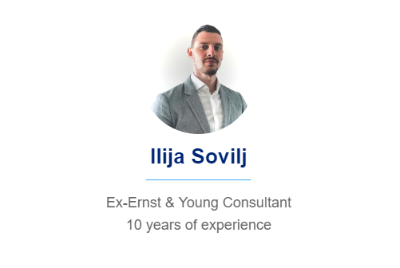
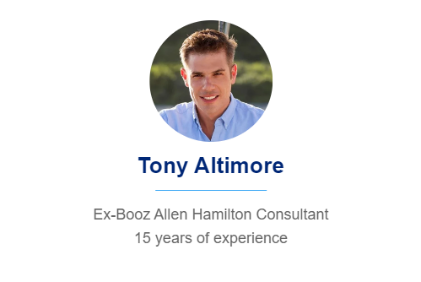
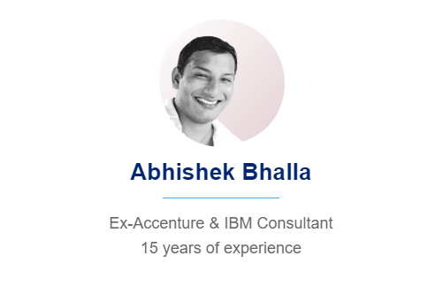
Need additional help? Send us a brief and we’ll find you the right talent from our network of 500+ tier-1 Management Consultants
Click here to send us a Project Brief

Slide 23
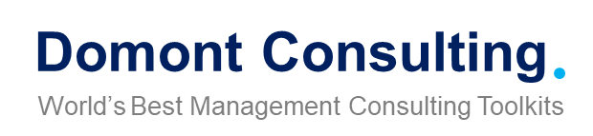
This was just a small preview.
www.domontconsulting.com

